Slide 1
Introduction to CHLA’s Peer Navigation Program
2023

Slide 2
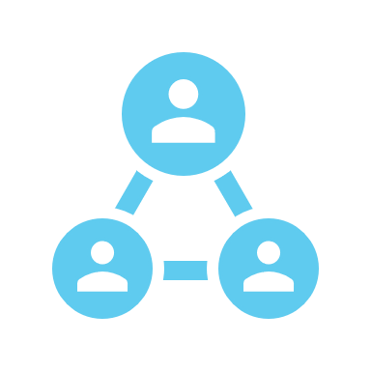
What is a Peer Navigator?
A Peer Navigator is an individual who helps other through a process with their own knowledge and experience.
Notes:
Briefly introduce the idea of peer navigators

Slide 3
How is CHLA’s Peer Navigator Program Different?
The Peer Navigator Program focuses on the ID/DD Transition Process from Pediatric to Adult services.
Peer Navigators are individuals with ID/DD who have transitioned from Pediatric to Adult services and supports.
CHLA’s Peer Navigation Program will provide 1:1 job coaching to assist as needed.
Notes:
Explain the need: A lot of individuals are given services for many years that will end at certain ages and there is no service or support availability leading to low percentages of community integration in employment, social, and educational settings. Peer Navigators have a unique skill set with their own personal experience and knowledge.

Slide 4
Why Peer Navigators?
Peer Navigators have a wealth of information they can share with individuals in their communities.
Peer Navigators can utilize their experience and knowledge to facilitate a sometimes complicated transition process for others to increase continued integration of individuals with ID/DD into their communities.
Peer Navigators can use their cultural lens and experience to make more meaningful connections and recommendations to program participants.
Notes:
Individuals know themselves best. That is why an individual with ID/DD who has experienced the difficulties with the transition process would be the best guide for individuals beginning or going through the process.

Slide 5
What is the Transition Process?
Peer Navigators will facilitate the Transition Process for Program Participants.
The Transition Process refers to the assistance that a Program Participant will receive to help them in their everyday life that they will need to continue into their adulthood.
Healthcare, Education, Employment, Financial, Living Skills, Community Integration, etc.
Each Program Participant will have a different plan for Transition and require different supports to achieve their goals.
Notes:
Briefly explain. Basic: Anything related to transition, the Peer Navigator can help with

Slide 6
Areas of Focus
Healthcare
Employment
Education
Independent Living
Community Integration
Notes:
“Umbrella” terms for the typical areas of transition

Slide 7
Peer Navigation Training
Peer Navigators will be given introductory “modules” for each area of focus in the transition process: health care, education, employment, independent living, and community integration
Modules will include: videos from CHLA’s transition summits, roleplaying, discussion, individual reflection, shadowing others at CHLA and interactive presentations with Project Coordinator.
Peer Navigators will be CHLA interns and will participate in the same hiring and orientation as any other CHLA intern.
Notes:
Theory behind it and the ability to adjust based on peers, participants, audience, etc.

Slide 8
Peer Navigation Training
In addition to informational training, Peer Navigators will be trained in Person Centered Practices, Case Management, and Communication.
Peer Navigators will be able to practice these skills by providing case management on a “practice” case and complete a Person Centered Plan for themselves with the Project Coordinator.
Training will be ongoing as the program grows and evolves to meet specific needs of the population it serves.
Notes:
Hands on training and the ability to remain flexible and lead into PCP and how flexibility is key for this ideology

Slide 9
Person Centered Practices and Planning
Person Centered Planning (PCP) is prioritizing the needs and wants of the individual who is transitioning their services from pediatric to adult care.
Peer Navigators will use a variety of Person Centered Plans to understand, breakdown, and provide next steps for the individuals utilizing Peer Navigation Services.
Peer Navigators will be introduced to: PATH (Planning Alternative Tomorrows with Hope), MAPS (Making Action Plans), and Solution Circles
If none of these PCP templates are appropriate for the individual’s goal, then the Peer Navigator can modify or create a plan to ensure the individual’s needs are met and there are clear next steps for the individual to take.
Notes:
Focus on ideology here and go into the planning process on next slides

Slide 10
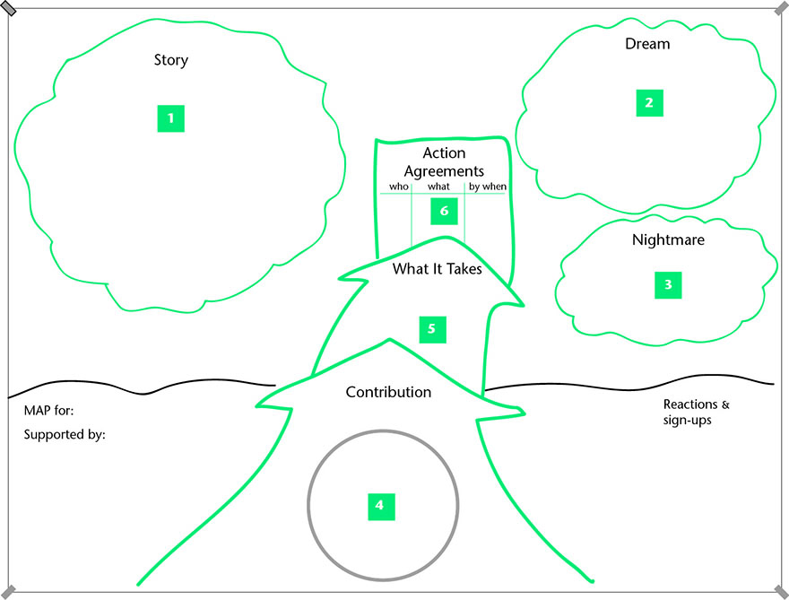
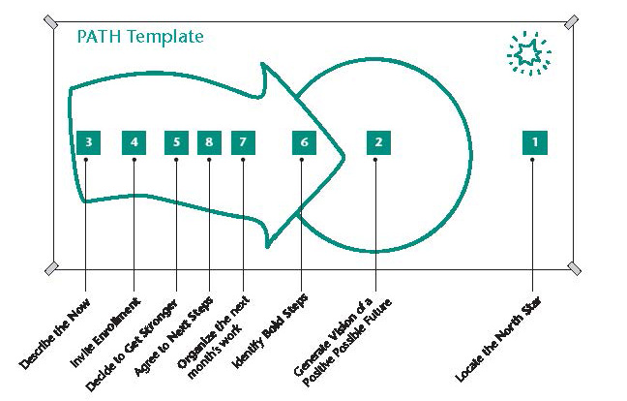
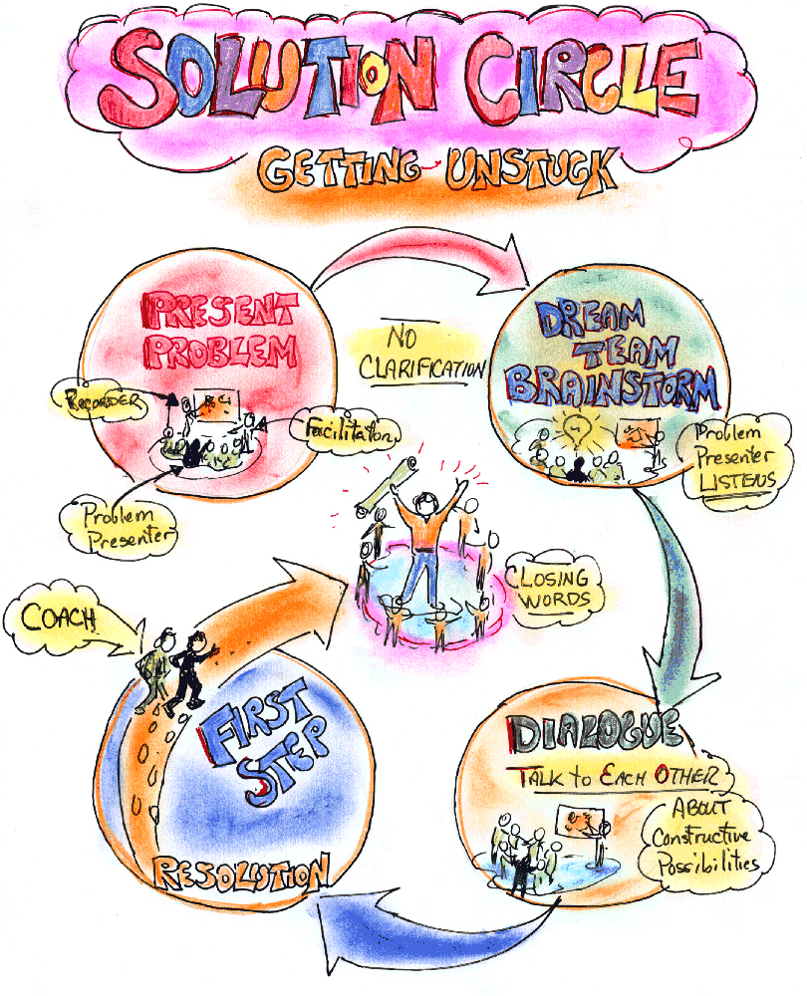
PCP Plans
Notes:
Explain that these are just examples from PCP agencies and can be changed based on needs, goals, and however the Peer Navigator and Program Participants can understand the barriers, supports needed, how the individual works, what the individual would like to do, etc.

Slide 11
Resource Hub
Always changing One Drive with resources related to the transition process.
Document with websites to generic resources and information
Applications for generic services
Brochures
CHLA made manuals
Resource drive will always grow and change with resources added from participants, navigators, and coordinators.
Notes:
Explain that this will never be complete as new resources are made, discovered, and new people bring their own experience and knowledge including program participants and peer navigators.

Slide 12
Peer Navigator Training Timeline
CHLA Orientation
Introduction to Peer Navigation
Complete All PN Trainings
Begin Case Management
Complete within 1 Week of Employment
Complete in 1-2 months of Employment
Notes:
Explain will likely change based on pilot program

Slide 13
Timeline Program Participant
Intake
Person Centered Planning
Weekly Case Management
Participant Transitions Successfully
Receive Referral with Participant's Contact Information
Call Participant and Complete Intake Questionnaire and Schedule PCP Meeting
*If Participant does not respond after 3 voice mails, close the case.
During meeting that was scheduled in Intake, create a Person Centered Plan and goals the participant wants to accomplish with Peer Navigator
Within 1 week, create a one page and set smaller goals to achieve bigger goal and discuss with Participant.
*If participant agrees to goals and next steps, continue to case management.
Call every Program Participant in your caseload 1x/week for status update and adjust goals, one sheet, and resources as needed.
Attend weekly Check In meetings with Coordinator to discuss difficult situations or other program supports.
Case closes when the Program Participant successfully achieves their goals or decides they no longer need Peer Navigation Assistance.
Notes:
Explain that timelines are flexible based on individual needs. This is most likely for someone at the very beginning of the process who needs intensive referrals.

Slide 14
Examples of Daily Peer Navigator Activities
Making case management calls
Updating case notes
Researching for resources for a Program Participant
Meeting with Program Coordinator for support regarding case management
Professional Development for ongoing knowledge of Transition Processes and needs
Notes:
Idea of what could happen. Note: It looks like every other general case manager professional

Slide 15
Examples of How a Peer Navigator Can Be Used
Attending an IPP meeting with an individual and their Service Coordinator to advocate for Services needed to attain IPP goals.
Assisting and individual with filling out a job application, writing, and submitting a resume and cover letter.
Brainstorm with an individual different steps to take to achieve a career goal, such as educational requirements and application process and then completing smaller steps towards the goal with the Program Participant.
Help an individual find an adult health care provider and specialists after aging out of pediatric care.
Notes:
Concrete support that a Peer can provide. Note: the peer is not doing for, but doing with. The participant will have to take the next steps to work towards transitioning their services.

Slide 16
Quality of Services in Peer Navigation
Ongoing research to ensure that the program is effective for Peer Navigators and Program Participants.
Qualitative data collected via introductory survey and exit survey.
Utilize this data to make the program adaptable and more widespread.
Notes:
Research from pilot program to grow and adapt the program in the future

Slide 17
Referrals and Funding
Referrals will come from community partners, family resource centers, and pediatricians.
Currently, PIP program will provide the salary for the Program Navigators.
The goal: The Peer Navigation program will provide foundational skills for the Navigator to receive full time employment in a healthcare setting.
Future Funding
Potential RC Vendorization, Program Replication, and DDS grants
Notes:
Ongoing programming will depend on monetary support and referrals.

Slide 18
Any Questions?
Notes:
El Fin

